Slide 1
Build Your Own Chatbot with Gemini API
By Reda KHERFALLAH

Slide 2
Bridging Language Gaps with Context-Aware AI

Slide 3
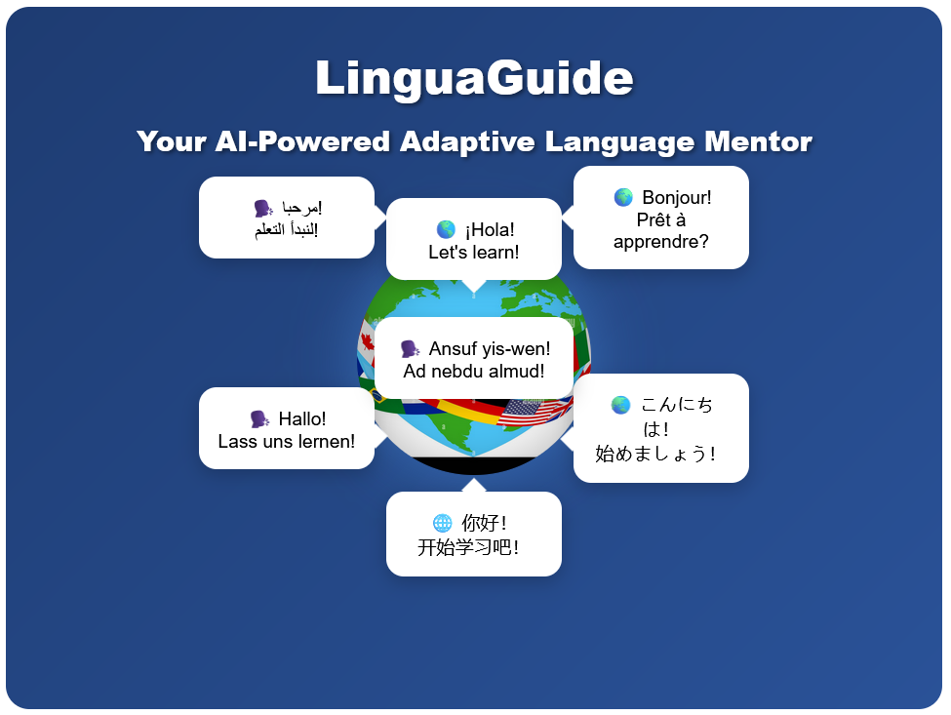

Slide 4
Problem Statement
One-size-fits-all approaches ❌
Cultural context gaps 🌍
Fear of mistakes in practice 😰
Limited real-world interaction 🤖
Traditional Language Learning Pain Points

Slide 5
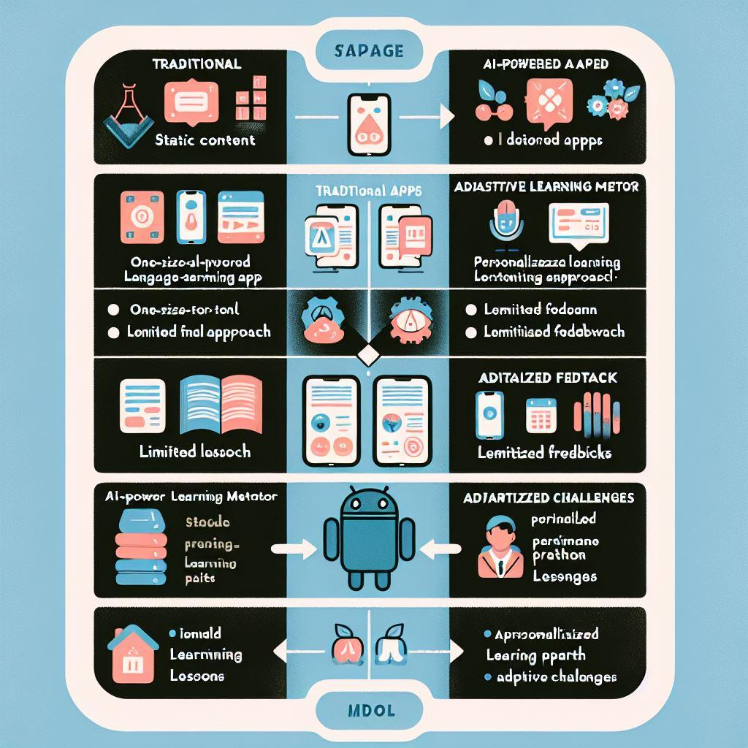

Slide 6
Our solution

Slide 7
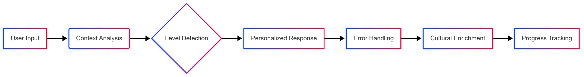
LinguaGuide's Core Capabilities

Slide 8
Key Differentiators
Adaptive personality matrix
Cultural context engine
Mistake-driven learning

Slide 9

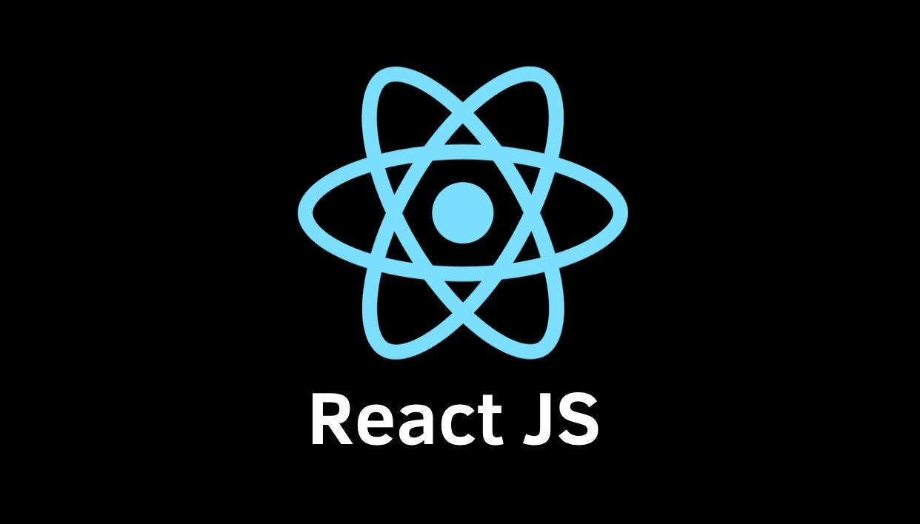
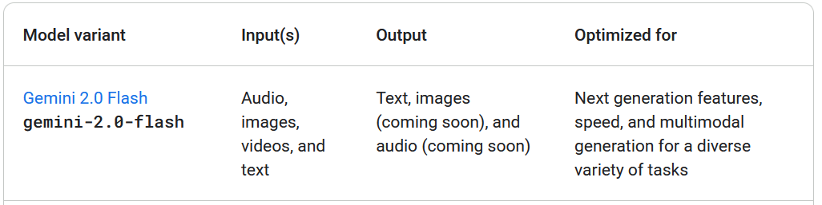
Technical Choices
Target Audience
Anyone with an enthusiasm for language learning
Focus: Travelers ✈️, Professionals 💼, Culture Enthusiasts 🎭

Slide 10

Demo …

Slide 11
Conclusion
Language learning shouldn't be a solo journey. With LinguaGuide, every mistake becomes progress, and every interaction brings cultural discovery.
Beyond Conversations: Building a Holistic Learning Ecosystem

Slide 12
Critical Perspectives for Growth :
Perspective | Challenge | Solution
Database : Personalize learning paths using historical data 📊 Quantify progress (e.g., "You’ve mastered 82% of A1 German!") Enable spaced repetition algorithms 🔄 | Real-time sync with LLM context | Redis caching for session states
Audio/Visual : Cater to diverse learning styles (auditory/visual learners) 🎧👀 Enable pronunciation feedback via speech-to-text 🎤 | Large media storage costs | Cloudflare R2 + on-demand transcoding
Fine-Tuning : Domain-specific optimization (e.g., medical Spanish vs. travel Spanish) 🏥✈️ Reduce hallucinations in cultural explanations 🧠 | Overfitting to textbook phrases | Hybrid human-AI dataset curation

